Slide 1
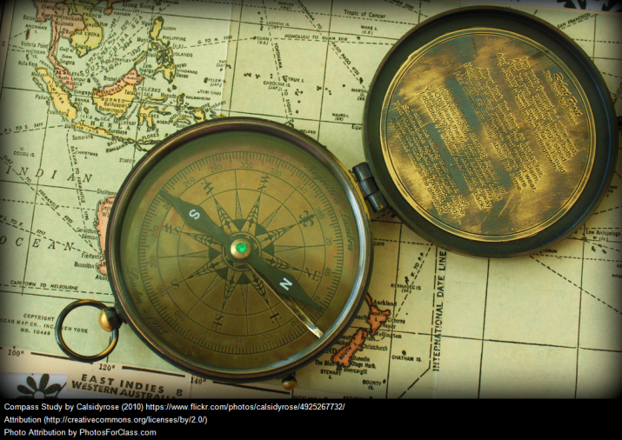
using the internet for research
Mr. Willard

Slide 2
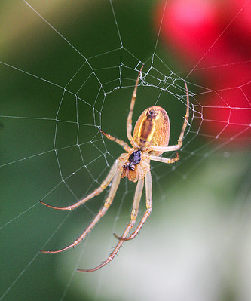
Search Engines
A search engine is a program designed to search for documents on the Internet using keywords. Examples: Google, Bing, Infotopia
Uses software robots called “spiders” to search millions of pages on the World Wide Web
Stores information compiled by spiders into a huge online library called an index
Fetches results from indexes when a user types in keywords
Sorts and displays information using a complex program called an algorithm
Robots (“Spiders, Webcrawlers”)
No more human selection
Collection rather than selection—everything on the Web is included in a search
Show Google and show number of sites indexed (at bottom of front page) and number of hits for a key word (e.g. “Columbus”).

Slide 3
Website addresses
Websites have an address called a Uniform Resource Locator (URL)
Top-level domains tell you what kind of person or organization runs the site:
.com = commercial
.org = organization (usually non-profit)
.edu = educational institution (usually college)
.gov = government agency
.edu and .gov are restricted; others are available to anyone who wants to use them
Personal web pages: the tilde (~)

Slide 4
The Publication Process
Book:
Author
Publisher
Editor
Bookstores
Reviewer
Librarian
Advantage: At each level, poorly-prepared materials are weeded out
Internet:
Author
Internet
Disadvantage: No selectivity; anyone can publish

Slide 5
The Good stuff
Subscription databases: Include journals, magazines, newspapers, books and more. Most are available via the Internet, but aren’t freely available to the public. Libraries make them available, though.
Subject directories: Allow you to browse Internet resources by subject category. They are created and maintained by human editors (librarians) that review and select sites based on usefulness.

Slide 6
research suggestions
Remember - not everything on the Internet is reliable
To get familiar about a topic, read a book first
Check facts with other sources

