Slide 1
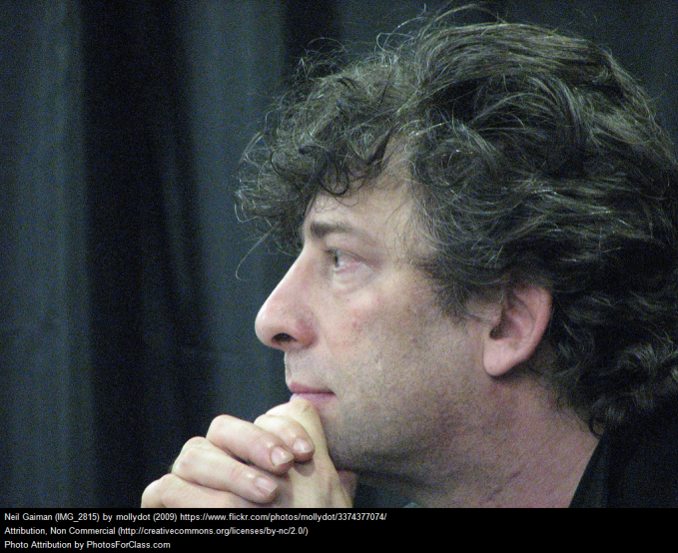
Neil Gaiman: Reflections on Bullying
Mr. Willard
2016

Slide 2
Neil Gaiman
Neil Gaiman is one of the most prolific and respected authors alive. Many know him best as the author of “Coraline”

Slide 3
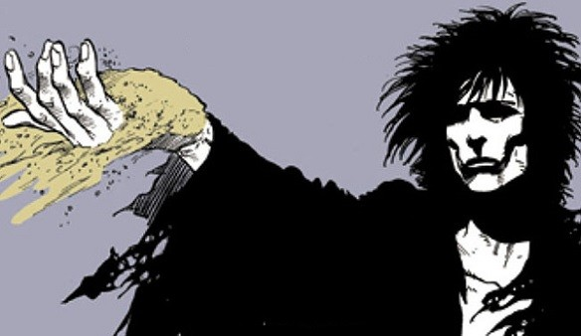
Neil Gaiman
His work also includes “The Sandman” and numerous other graphic novels

Slide 4
Neil Gaiman
https://youtu.be/lzrwm3unAgQ
https://youtu.be/8HVN4f-RINc
https://youtu.be/VlwTjX9KAqw

Slide 5
Neil Gaiman

Slide 6
Neil Gaiman

Slide 7
Your Turn
In Word, write a reflection (300 words or more) on one (or more) of Neil Gaiman’s comments:
Trying to be the same as everybody else is a strategy that kind of works in school.
Do not spend your days worrying about what people think about you.
There is no excuse for a culture of hate.

